Slide 1
Food Chains and Food Webs

Slide 2
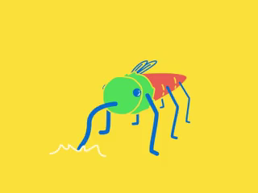
By the end of the lesson, you should be able to:
1. | Explain what a food chain is.
2. | Explain what a food web is.
3. | Construct a food chain and food web.

Slide 3
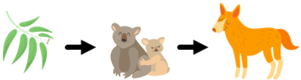
All living organisms need to consume some type of food for survival.
Food chains show the relationships between producers, consumers and decomposers.
They are a visual way of showing who eats what. The direction of the flow of energy in a food chain is shown by the direction of the arrow.

Slide 4
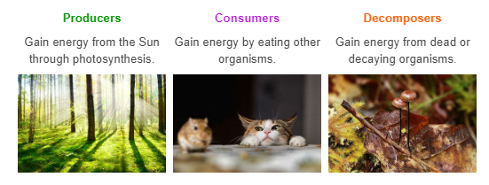
Let's quickly go over the difference between producers, consumers and decomposers.

Slide 5
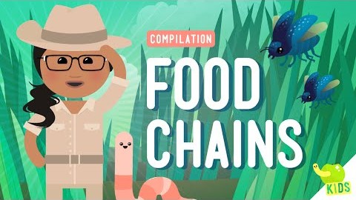

Slide 6
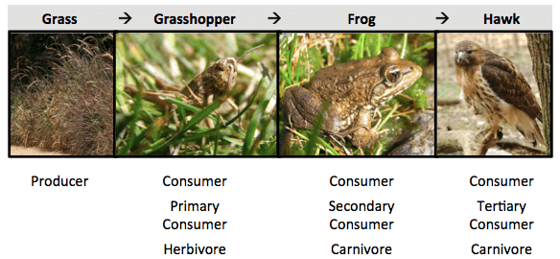
The arrows in food chains point from the organism that is being eaten to the organism doing the eating.
In the food chain below, the hawk eats the frog, the frog eats the grasshopper, and the grasshopper eats the grass.

Slide 7

Producers are always the first link in a food chain.
Animals that feed directly on producers are called first order consumers (herbivores).
Animals that consume herbivores are second order consumers (carnivores or omnivores).
Third order consumers are at the top of the food chain - they are very rarely preyed upon by anything else.

Slide 8
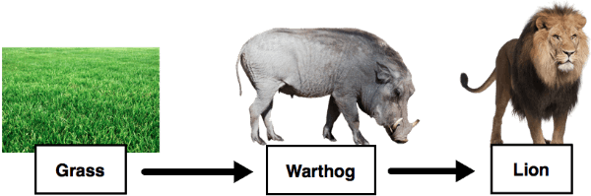
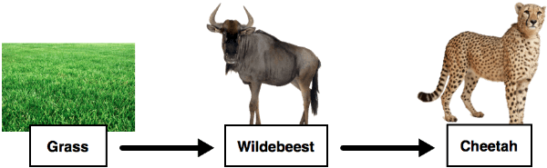
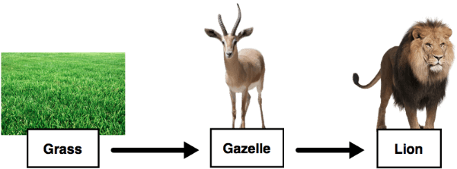
Take a look at each of these food chains.
They all occur in the same ecosystem - the African Savannah.

Slide 9
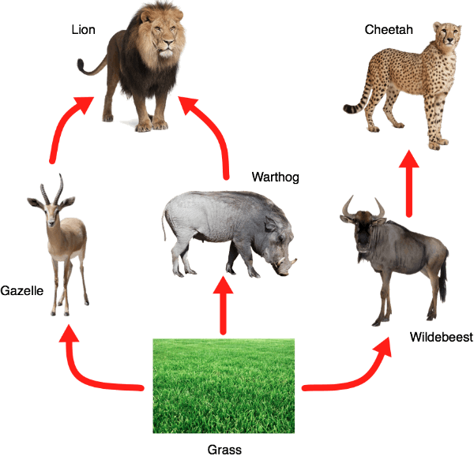
More than one food chain usually exists within an ecosystem, since there are so many organisms!
All of the interlinked food chains within an ecosystem are known as a food web.
The three food chains from before can all be represented much more easily in a food web.

Slide 10
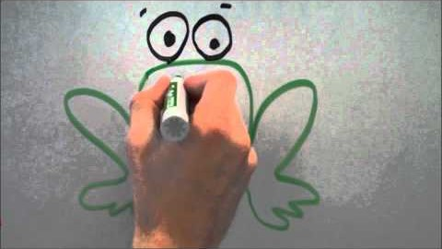

Slide 11
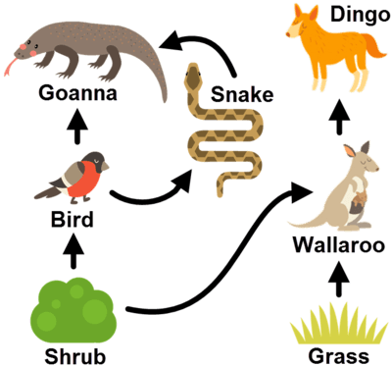
A food web is simply a collection of all the food chains in an ecosystem.
The below diagrams show the comparison between a food chain and a food web.
Remember: The arrows point to the organism that is doing the eating!
Food Web
Food Chain

Slide 12
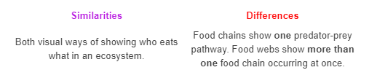
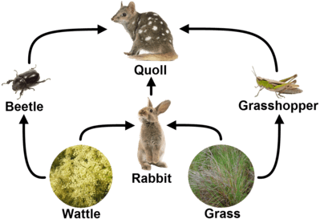
There are some similarities and differences between food chains and food webs.

